Slide 1
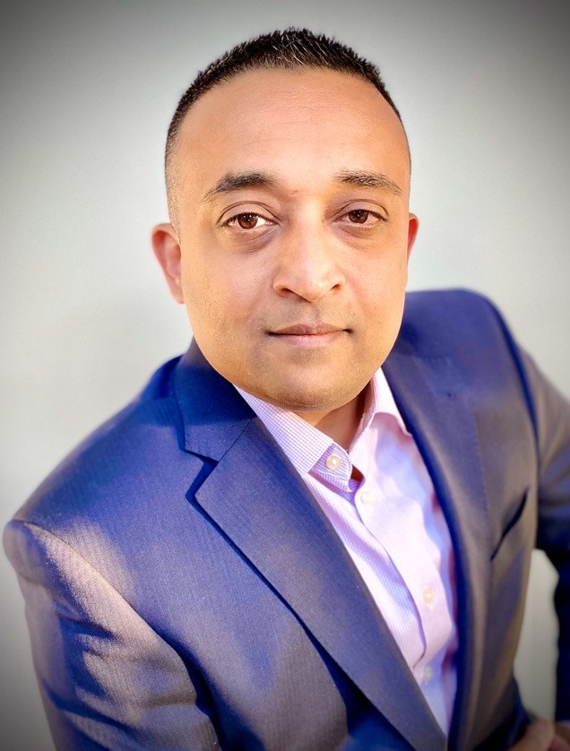
SOS: Save Our Systems
Nim Nadarajah
Job Title
Company Name

